Slide 1

Wine Quality Predictor
AI Application Project — Machine Learning for Quality Classification
KUNAL · 25BAI70432
AKSHIT · 25BAI70679
SHIVAM · 25BAI70897
DAKSH · 25BAI70806
LOVENISH · 25BAI70632

Slide 2

What Is Wine Quality Prediction?
Wine quality prediction uses machine learning to estimate a wine's quality score (1–10) based on its chemical composition — eliminating the need for costly, time-consuming human sensory panels.
⚗️ Chemical Analysis
🤖 ML Classification
Lab-measured properties like pH, acidity, and alcohol serve as input features for the model.
Trained algorithms learn patterns linking chemical profiles to quality ratings.
🏭 Industry Impact
Enables faster, consistent quality control across production batches at scale.

Slide 3

Problem Statement
The Challenge
Wine quality is traditionally assessed by expert tasters — a process that is subjective, slow, and expensive. The goal is to build a model that predicts a wine's quality score (1 to 10) using only measurable chemical properties.
Input
Output
Approach
11 chemical features per wine sample
Predicted quality score (integer 1–10)
Supervised ML classification / regression

Slide 4
Dataset Overview
The project uses the UCI Wine Quality Dataset — a widely cited benchmark in ML research, combining physicochemical test results with sensory quality ratings.
7,348
11
Total Samples
Input Features
Wine instances across red and white varieties
Chemical and physical properties per sample
1
12
Target Variable
Total Columns
Quality score rated 1–10
Including the quality label

Slide 5




Key Features Explained
Each wine sample is described by 11 physicochemical measurements that collectively influence taste, aroma, and perceived quality.
Fixed & Volatile Acidity
pH & Density
Measure tartness and vinegar-like notes; key to flavor balance.
pH indicates acidity level; density reflects sugar and alcohol content.
Alcohol Content
Sulfur Dioxide
Strongly correlated with quality — higher alcohol often signals better fermentation.
Free and total SO₂ act as preservatives, affecting freshness and stability.

Slide 6
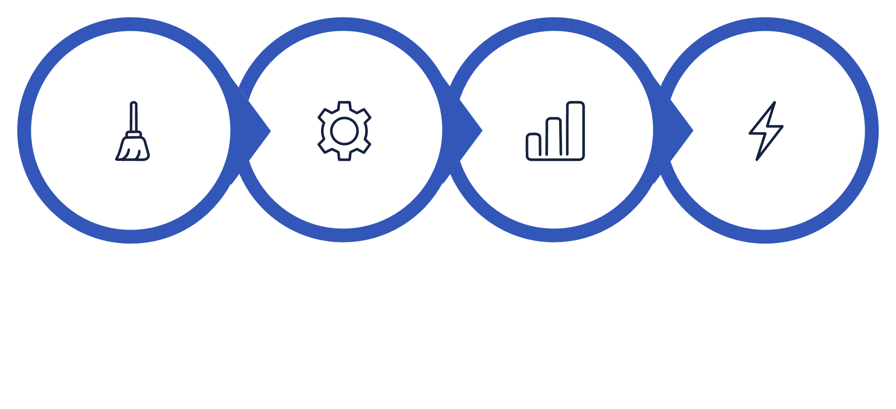




Methodology
Preprocess
Train
Evaluate
Predict
The pipeline follows a standard supervised learning workflow — from raw data cleaning through model evaluation — ensuring reproducible and reliable quality predictions.

Slide 7
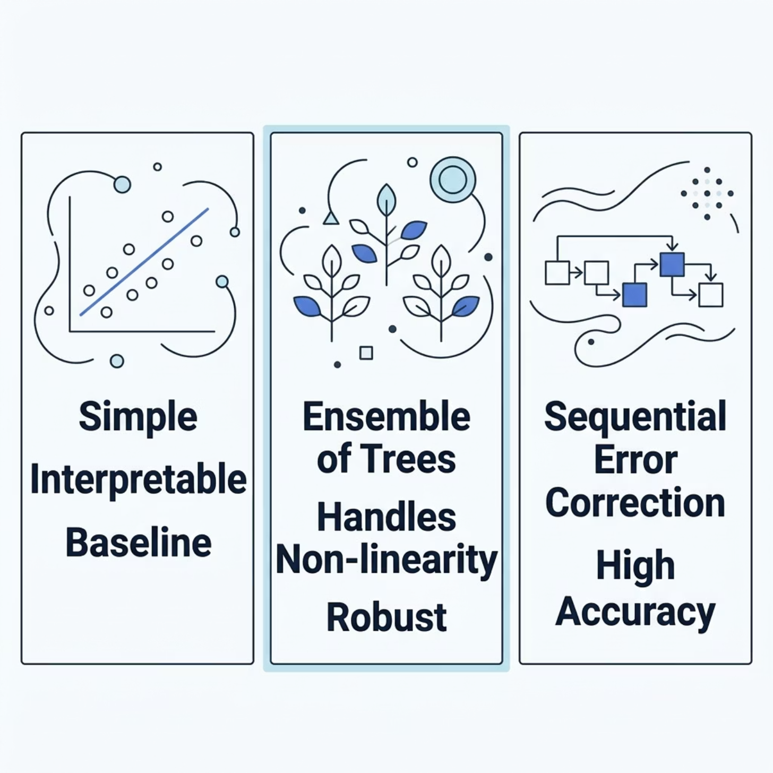


Model Selection
Why Random Forest?
Random Forest was selected as the primary model due to its robustness and ability to handle tabular data with mixed feature scales.
Handles non-linear relationships between chemical features and quality
Resistant to overfitting through ensemble averaging
Provides feature importance for interpretability

Slide 8









Implementation Stack
Python
Core programming language for all data processing and modeling
Google Colab
Cloud-based Jupyter environment — no local setup required
Pandas & NumPy
Data loading, cleaning, transformation, and numerical computation
Scikit-Learn
Model training, evaluation metrics, and preprocessing utilities

Slide 9
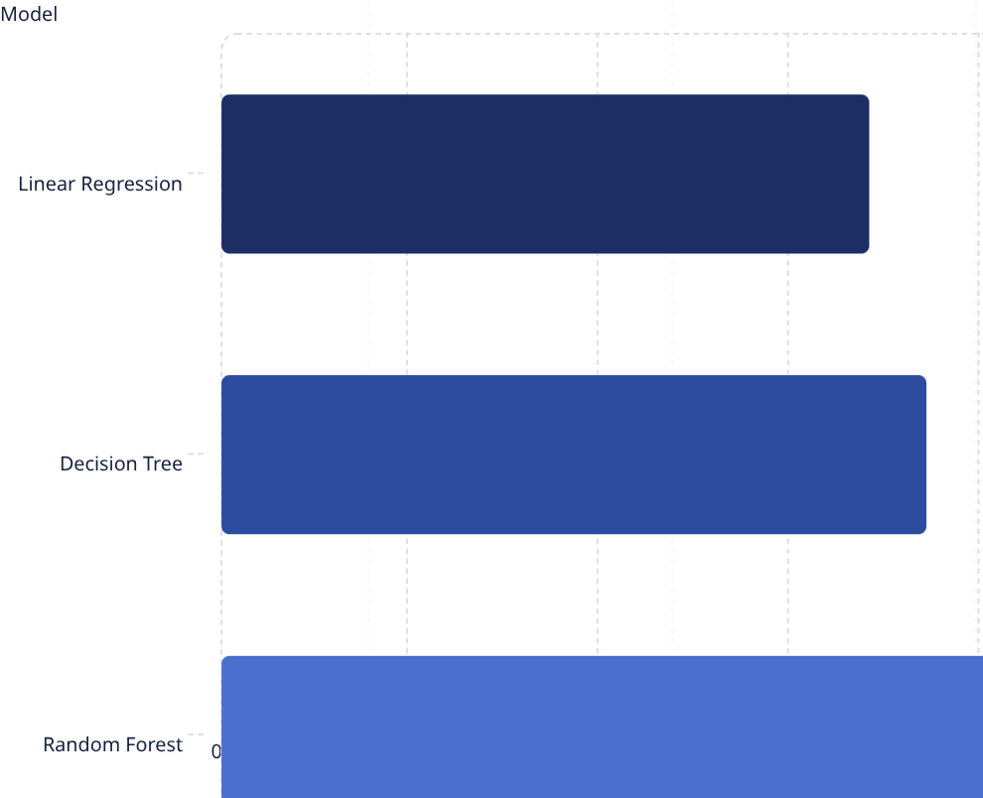
Results & Output
Model Performance
Random Forest outperformed baseline models, achieving ~81% accuracy on the held-out test set — a strong result for a 10-class quality prediction task.
Sample Prediction: Input chemical values → Model outputs a quality score of 6 / 10, classified as "Good" quality wine.

Slide 10
Advantages, Limitations & Conclusion
✅ Advantages
🔭 Limitations & Future Scope
Fast, consistent predictions vs. human tasting
Supports data-driven quality control in wineries
Reduces cost and subjectivity in testing
Feature importance reveals key quality drivers
Accuracy can improve with larger, more diverse datasets
Model limited to chemical features — no aroma/taste data
Future: real-time deployment via API or mobile app
Explore deep learning for higher precision
Key Takeaway: This project demonstrates how supervised ML can automate a traditionally subjective process — delivering measurable value to the wine industry.

